Slide 1
Multi-agent Coverage
Planning System
TEAM
TECHKNIGHT’S ALLIANCE
IIT MADRAS

Slide 2
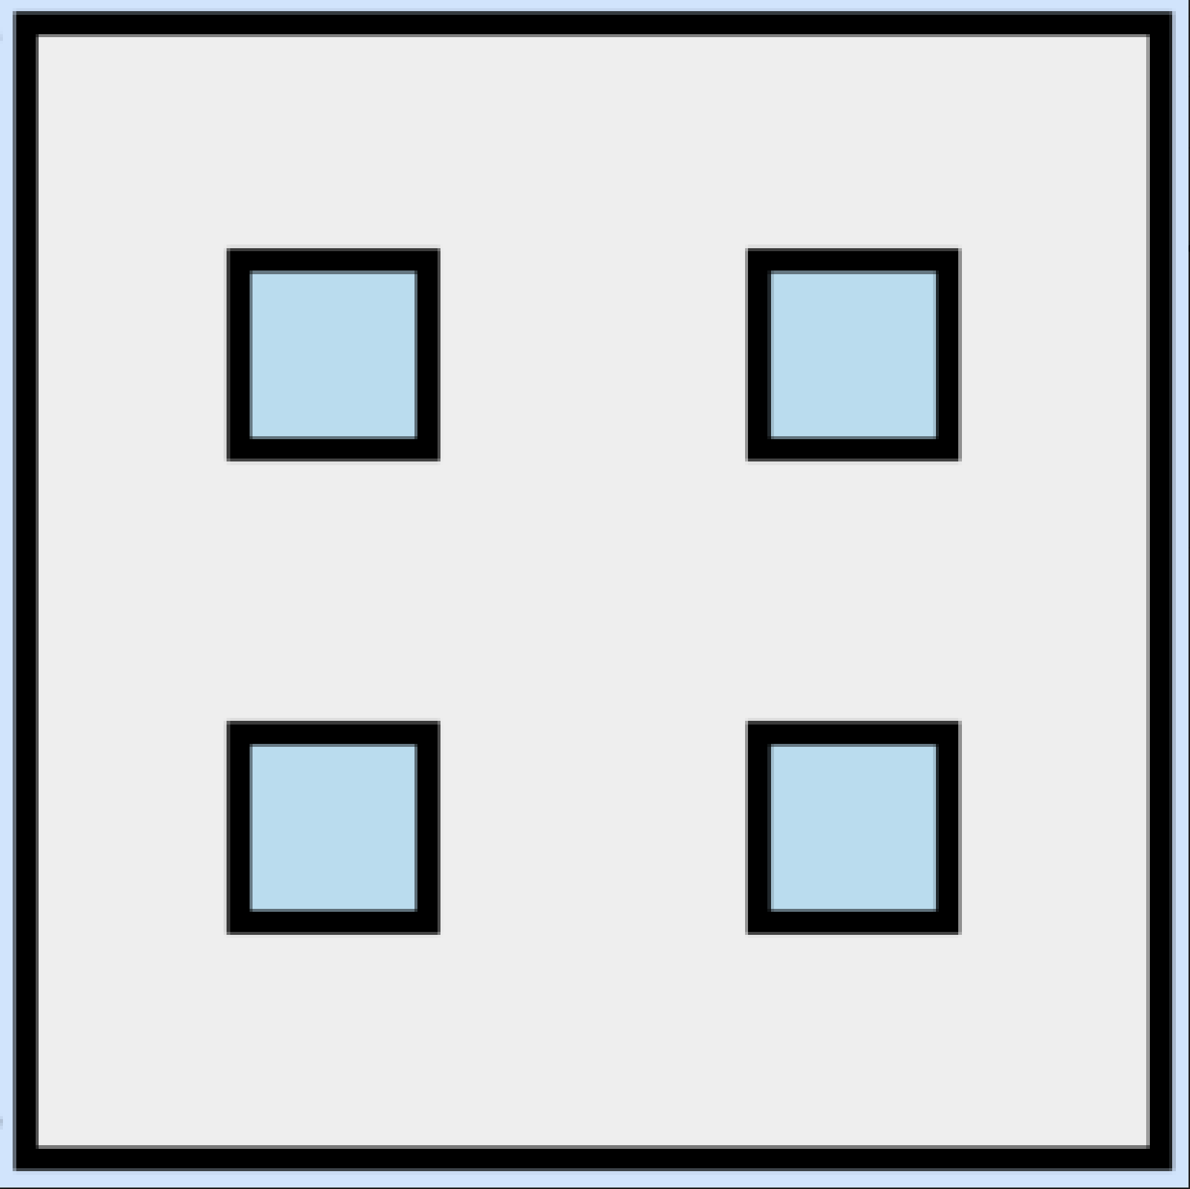
Simulation Configuration details
The simulation is being carried out on Map 2 with 3 bots, with the initial bot configuration for which we found has the least cleaning time.
If we consider the map to be a 50*50 grid with the top left cell to be index 0 and we keep increasing the index as we move right first and then down i.e. bottom right most cell will be index 2499.
Following this notation the initial positions of our bots are 95, 1297 and 1897 or in cartesian coordinates as (1,45), (25,47) and (37,47).
Also, all the robots are made to cover nearly equal areas to minimize the overall time of the simulation.
Map Layout

Slide 3
